Slide 1
OTC Markets
SEC Small Business Advisory Committee
Washington, D.C.
February 25, 2025

Slide 2


How Does OTC Markets Group Help U.S. Small Businesses?
Overview of OTC Markets Group
Evolution of U.S. public markets
How companies can trade on our markets
    Reporting standards
    Market tier qualifications
    Investor protection

Slide 3
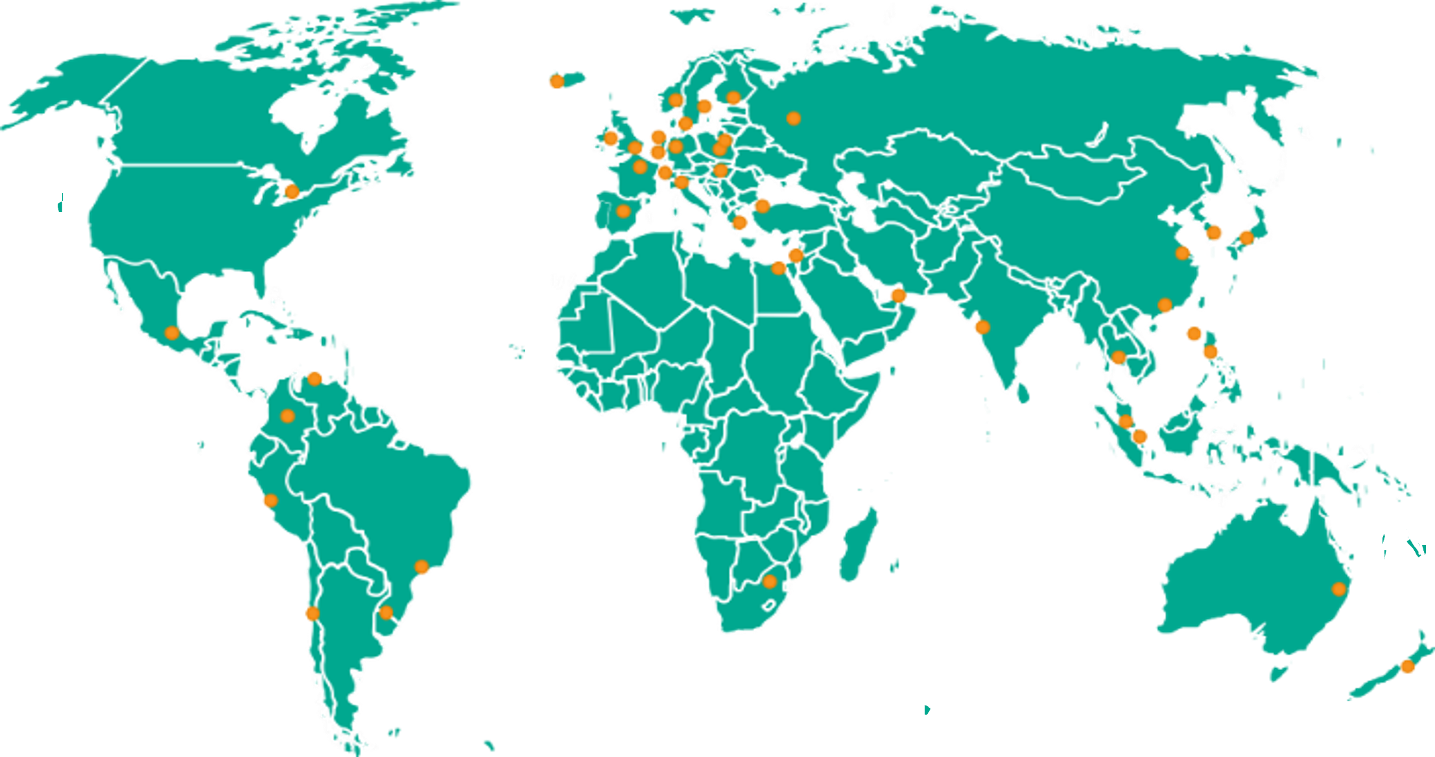





We Organize 12,000+ Securities Into
Disclosure Driven Markets
Our Mission: To create better informed and more efficient financial markets
Expert Market
3
Notes:
As of 12/31/24 worldwide:
$27.1 trillion+ total market capitalization
$478 billion annual dollar volume
12,000+ securities connecting over 50 recognized global exchanges
The largest US institutional investors, such as T. Rowe Price Management, Pershing Square Capital Management, and Horizon Kinetic Asset Management, are shareholders in OTCQX and OTCQB securities
Citadel, Jane Street, StoneX, Virtu, GTS and others are amongst the 100+ regulated market makers that provide continuous liquidity for OTCQX and OTCQB securities

Slide 4



HISTORICAL TIMELINE
1997
1999
2003
2007
2010
2012
2013
2014
National Quotation Bureau is purchased by investors led by current CEO
Launch of Electronic Quoting Capabilities
Launch of Electronic Messaging Functionality
OTCQX Best Market Introduced
OTCQB Market Introduced
OTC Link ATS registered with the SEC
SEC Grants OTCQX & OTCQB “Established Public Market” Status
  OTCQB Elevated Standards Introduced
  Compliance Data File Launched
2024
2022
2021
2019
2017
2016
  41 Jurisdictions Recognizes OTCQX for Blue Sky
  Launch of OTC Overnight Trading
Acquisition of Edgar Online & Blue Sky Data Corp Businesses
Amended SEC Rule 15c2-11 solidifies our status as a Regulated Market Operator
Acquisitions of Virtual Investor Conferences
& Qaravan Announced
  Compliance Analytics Product Introduced
  OTC Link ECN Launched
Vermont 1st State to Recognize OTCQX as a securities manual
*
2016 2017 2018 2019. 2020 2021 2022 2023 2024
*2024 Estimated
Notes:
The US public markets have changed in the last 10 years…
Our ATS trading platforms are regulated by FINRA and the SEC (2012)
OTCQX and OTCQB companies receive Blue Sky exemptions in the majority of US states, enabling broker-dealers to make recommendations and distribute research (2016-2024)
Investors are able to trade OTCQX and OTCQB securities through the broker of their choice, allowing a company to grow and diversify its shareholder base (2021- 15c2-11 amendments / transformative for business…next slide explains 15c2-11)

Slide 5
Exchange Act Rule 15c2-11
15c2-11 requires that current information about an issuer be publicly available in order for a broker-dealer to quote that issuer’s security
OTC Link ATS is recognized as a qualified interdealer quotation system (QIDQS) under 15c2-11, and it makes a daily “current information” designation for thousands of OTC securities
As a QIDQS, broker-dealers can rely on our current information designation to fulfill their obligations under 15c2-11

Slide 6
How Can a U.S. Company Trade OTC?
“Slow-PO”
Public offering (SEC-registered IPO or Regulation A)
Exchange de-listing

Slide 7
Our Reporting Standards
SEC
Bank
ARS
SEC-reporting (Section 13 or 15(d) of the Exchange Act)
Regulation A
Regulation CF
Investment Companies
U.S. bank / bank holding company
U.S. thrift / thrift holding company
U.S. financial institution filing reports with U.S. bank regulator
OTC Markets’ “catch-all” Alternative Reporting Standard under 15c2-11
OTCQX and OTCQB Disclosure Standards
For companies that are not SEC- or Bank-reporting companies

Slide 8
Eligibility Standards
Audited annual financials (PCAOB)
Not be a Shell or Blank-Check Company
Not a Penny Stock
Not be in bankruptcy
Corporate governance standards
50 beneficial shareholders / 100 shares each
Bid price of $0.25
Market cap of $10 million
10% public float
Proprietary priced quotations requirement
Transfer agent requirement
Audited annual financials (PCAOB)
Bid price of at least $0.01
Not be in bankruptcy
Corporate governance standards
50 beneficial shareholders / 100 shares each
10% public float
Transfer agent requirement

Slide 9
U.S. Companies on
506 U.S. companies across OTCQX and OTCQB
47 states represented (plus D.C. and Puerto Rico)
Across 144 industries
$13.02 median share price – OTCQX
$45.2 billion total dollar volume traded in 2024
275 U.S. company graduates to a national securities exchange since 2019
Data as of 12/31/24 unless otherwise noted.

Slide 10











Our Risk Flags
Notes:
(Top): Shell Risk – Promotion Flag – Bankruptcy – Control Dispute – Prohibited Service Provider – Unable to Contact – Delinquent SEC Reporting
(Bottom): Pink Limited Information – Dark or Defunct – Caveat Emptor – Expert Market

Slide 11
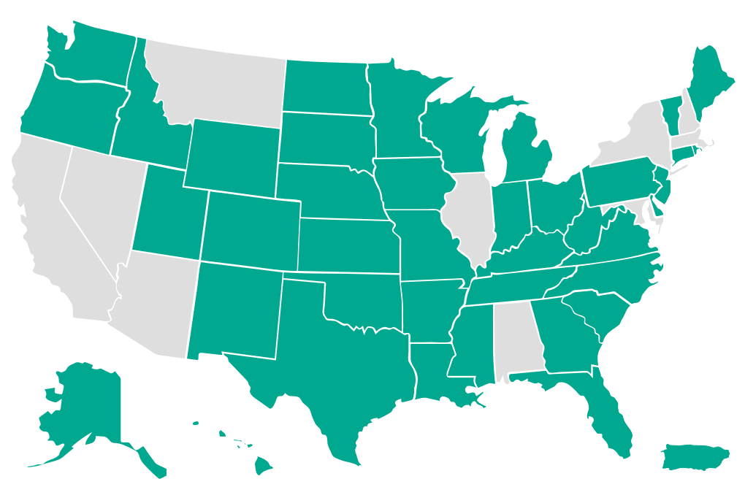
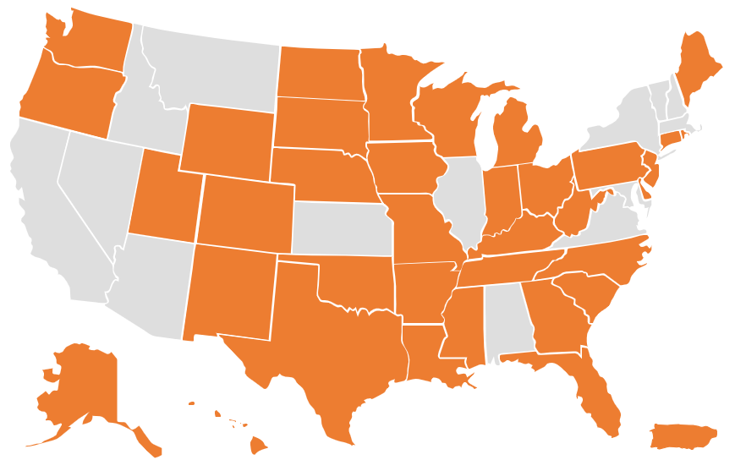
Blue Sky Recognition
We are continuously working with state regulators to achieve Blue Sky exemption for the OTCQX Best Market and the OTCQB Venture Market in individual states through formal rule changes, no-action letters, administrative orders and trading exemptions.
As of February 25, 2025, our OTCQX and OTCQB markets are exempt from state Blue Sky laws regarding secondary trading in 41 and 37 jurisdictions, respectively.

Slide 12
How Can Regulators Help U.S. Small Businesses Trade OTC?
Education
Interpretive Guidance
Capital Raising Proposals
Investor Protection Initiatives

Slide 13

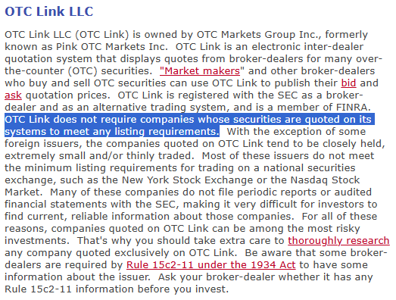
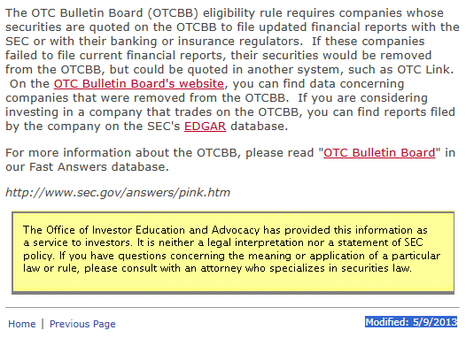
Education
Information about the OTC market is outdated and incomplete
Source: https://www.sec.gov/answers/pink.htm

Slide 14
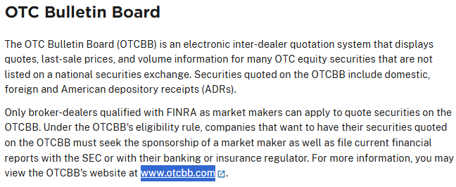
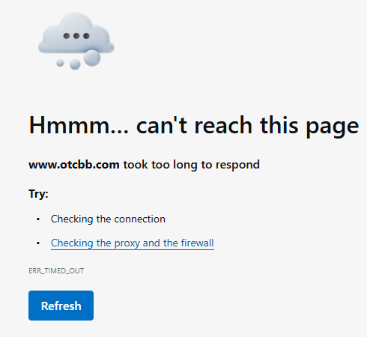
Education
Source: https://www.sec.gov/about/divisions-offices/division-trading-markets/over-counter-market

Slide 15
Interpretive Guidance
Issue updated guidance that enables broker-dealers to safely and reliably process transactions in low-risk OTC securities
  Encourage FINRA to revisit Regulatory Notice 09-05
    Many of the issues raised in Notice 09-05 have been addressed by the 2021 15c2-11 amendments and our tiered market structure and disclosure requirements
  Provide a framework for steps companies can take to resume public trading in their securities following an SEC trading suspension

Slide 16
Capital Raising Proposals
Allow at-the-market (ATM) offerings for smaller companies
  Lower the S-3 public float filing threshold
  Lower smaller companies’ cost of raising capital by allowing ATM offerings in conjunction with a Regulation A+ offering
    Limiting the offering amount limits the risk to the public
    Smaller companies are less inclined to seek out dilutive and predatory financing terms

Slide 17
Capital Raising Proposals
  Enable margin eligibility for qualified OTC securities
  Holders of margin-eligible securities can access the value of their holdings by borrowing against them, which increases the utility of owning those securities and ultimately encourages investors to purchase them
  Adequate current information and active trading on an established public market will ensure that margin eligible securities are easily valued and traded
  Use existing ESOP criteria outlined in SECURE Act 2.0 or our OTCQX highest-tier standards to determine margin eligibility

Slide 18
Capital Raising Proposals
Promote healthy competition and diverse choice among trading venues
  Reject anti-competitive proposals like the Main Street Growth Act (H.R. 2899) that would lead to a centralized trading monopoly of listed stock exchanges or any other trading venue
  Trading on multiple broker-dealer internal systems, crossing networks and ATSs provides benefits to investors and drives liquidity
  This diversified network model creates efficiencies for investors by incentivizing network intermediaries to add value in price, speed or execution quality

Slide 19
Investor Protection Initiatives
Increase disclosure requirements for promoters and significant holders of publicly-traded equities
  Update Section 17(b) of the Securities Act to provide for increased disclosure regarding stock promotion
  Extend Section 13(f) of the Exchange Act to require disclosure of institutional holdings in all publicly traded securities (including OTC-traded securities)
  Increase insider and affiliate disclosure on Forms 3, 4 and 5

Slide 20
Investor Protection Initiatives
Blue Sky preemption for eligible OTC securities
  Codify the OTCQX and OTCQB disclosure requirements as appropriate investor protection
    A majority of states have already made this determination
    The lack of a uniform Blue Sky manual exemption introduces significant compliance costs for broker-dealers and imposes needless restrictions on individual investors

Slide 21
Investor Protection Initiatives
Push exchanges to end the “lawful but awful” practice of keeping non-compliant companies listed for up to a year+
  Our markets are well-regulated and transparent, and delisted companies have a home on which to trade
    Our OTCQX and OTCQB markets offer efficient, regulated trading in an environment more suited to smaller companies
    We help identify risk (as opposed to exchanges that project a riskless model for all securities) and provide broker availability and investor access to disclosure

Slide 22
Thank you.
Questions?
Dan Zinn
dan@otcmarkets.com

